Slide 1


SMART INDIA HACKATHON 2025 TITLE PAGE
Problem Statement ID –SIH25027
ProblemStatementTitle-BlockAyurvedicchain-Based Traceability
Theme-blockchain&cybersecurity
PS Category- Software
Team ID-63102
Team Name (Lamentis)

Slide 2
Blockchain-Based Traceability of Ayurvedic Herbs
lamentis
Proposed Solution (Describe your Idea/Solution/Prototype)
Blockchain-based Traceability: A tamper-proof blockchain ledger to record every step from herb collection to the final Ayurvedic product.
Geo-tagging & IoT Integration: Herbs are geo-tagged at the point of collection using GPS-enabled IoT devices, ensuring authenticity of origin.
Digital Records Across Supply Chain: Farmers, transporters, processors, and manufacturers update records on the blockchain, ensuring transparency.
QR Code-Enabled Labeling: Each final Ayurvedic product package will have a unique QR code. Scanning reveals the entire journey of the herb.
Authentication & Quality Control: Real-time verification of source, handling, and processing ensures herbs are pure, safe, and compliant with AYUSH standards.
Uniqueness: First-of-its-kind integration of Ayurveda + Blockchain + Geo-tagging, building global trust in Ayurvedic medicine.

Slide 3
Technical Approach
lamenits
SIMPLE FLOWCHAT
START
│
▼
Herb Collection (with Geo-tagging)
│
▼
Data Entry on Blockchain
(Collector ID, Location, Time, Herb Type, Quality Check)
│
▼
Transportation/Storage
(Temperature, Handling, Logistics Data logged on Blockchain)
│
▼
Processing & Drying
(Quality Tests, Batch ID, Lab Reports uploaded to Blockchain)
│
▼
Manufacturing of Ayurvedic Formulation
(Ingredient Traceability, Quantity, Compliance Data on Blockchain)
│
▼
Packaging & Labeling
(Unique QR Code / RFID linked to Blockchain Record)
│
▼
Distribution & Supply Chain
(Retailer/Wholesaler details logged)
│
▼
Customer Scans QR Code
(Sees full traceability: Collection Point → Processing → Final Product)
│
▼
END
TECHNOLOGYS
1. Blockchain:Hyperledger Fabric / Ethereum (private) for immutable, tamper-proof supply chain records.
2. Database & Storage: Amazon DynamoDB + IPFS for herb data, images, and batch records.
3. Backend: Python (FastAPI) & Node.js for APIs, blockchain integration, and real-time updates.
4. Frontend: React.js / Angular for dashboards and consumer-facing apps.
5. IoT & Security: GPS geo-tagging, QR code scanners, end-to-end encryption for tracking & authenticity.

Slide 4
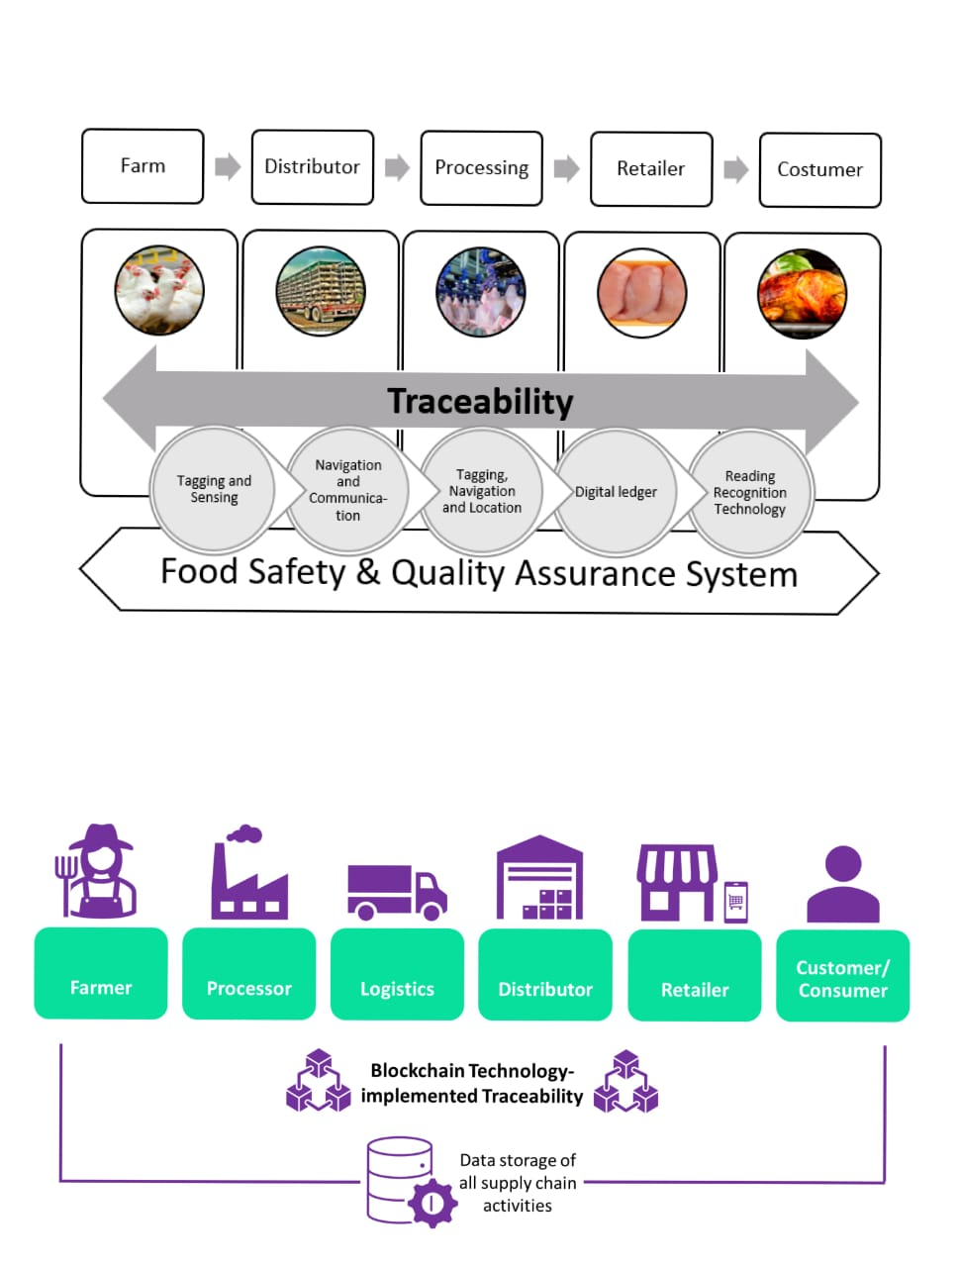
Blockchain-Based Traceability of Ayurvedic Herbs DIAGRAM

Slide 5
Feasibility & Viability
lamentis
Feasibility & Viability
Tamper-proof Transparency: Blockchain ensures immutable records for every herb from farm to factory.
Smart Tracking: GPS geo-tagging & QR codes enable real-time traceability.
Scalable & Cloud-ready: Cloud infrastructure supports growth without limits.
Economic Upside: Verified herbs fetch premium prices and reduce fraud-related losses.
Farmer Empowerment: Local-language apps & training bring digital literacy to rural collectors.
Regulatory Ready:Simplifies compliance with global standards and audits.
Sustainable Impact: Encourages eco-friendly harvesting and protects biodiversity.
Adoption Made Easy: Mobile-friendly tools & NGO/government support lower entry barriers.

Slide 6
Impact & Benefits
lamentis
IMPACTS
* Builds trust in Ayurveda
* Reduces adulteration & counterfeit herbs
* Empowers farmers
* Promotes sustainable harvesting
Strengthens global credibilityof Ayurvedic medicine
BENEFITS
* Regulatory: Transparent data, simplified audits, curbs illegal trade
* Economic: Higher market value, premium exports, reduced losses
* Environmental: Eco-friendly supply chains, controlled harvesting
* Healthcare: Safe, high-quality herbs, reliable supply

Slide 7
Research & References
lamentis
WHO – Traditional Medicine Strategy 2014-2023 https://www.who.int/health-topics/traditional-complementary-and-integrative-medicine
Ministry of AYUSH – Quality Control & Standards https://www.ayush.gov.in
Blockchain for Supply Chain Transparency (IBM Food Trust) https://www.ibm.com/blockchain/solutions/food-trust
Research Paper – Blockchain Technology in Agriculture https://doi.org/10.1016/j.jclepro.2020.120409
GPS & IoT in Agriculture https://www.sciencedirect.com/science/article/pii/S0168169918301126

